Slide 1
Live a Low-carbon Life

Slide 2
Self-introduction
Kent Xu (A3JP3ZZ)
MAIL: kxu4@mmm.com
Be responsible for COFS system

Slide 3
What is low-carbon life?

Slide 4
The definition of low-carbon life
Low-carbon life means a kind of life style that people do their best to reduce energy consumption and carbon greenhouse gas emissions.

Slide 5
Why do we
advocate low-carbon life?

Slide 6
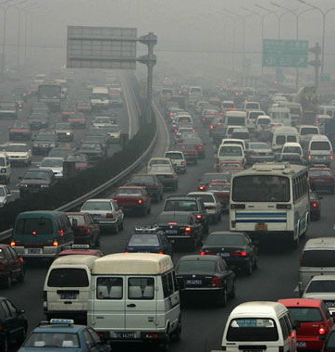
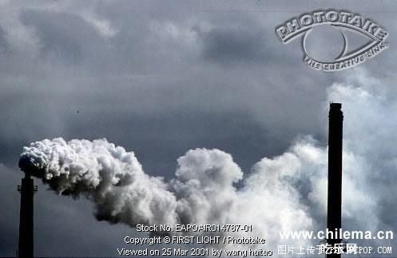
A large amount of exhaust gases has seriously influenced us, such as: cough, throat inflammation.

Slide 7
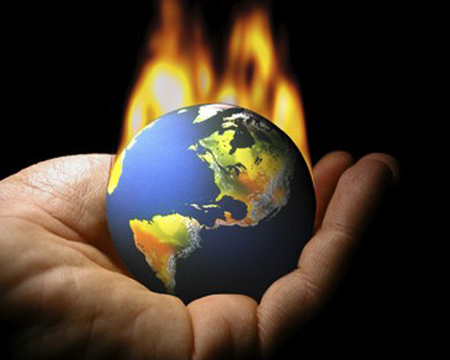
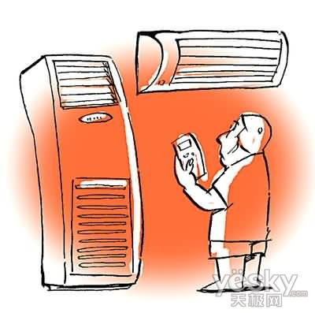
Air conditioning is bound to bring some burden on our environment
We use any kind of industrial products, air conditioning is bound to bring a certain burden to our environment.

Slide 8
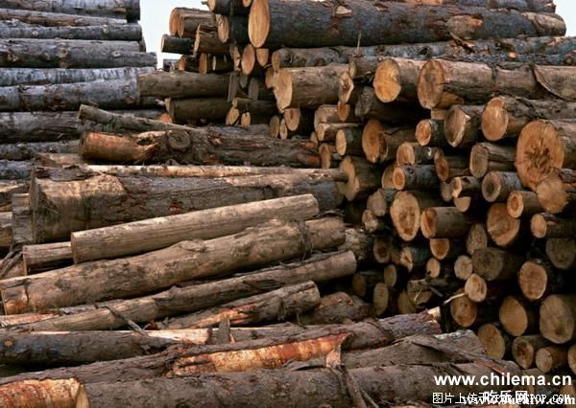
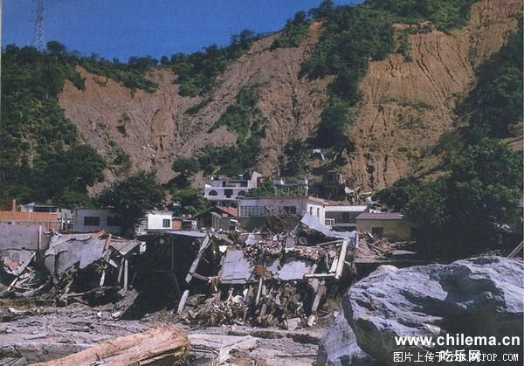

Slide 9
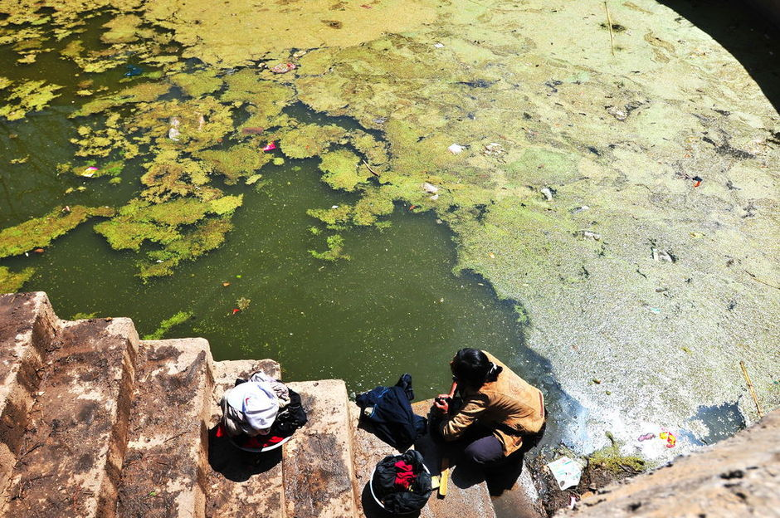
70% of Chinese rivers are polluted

Slide 10
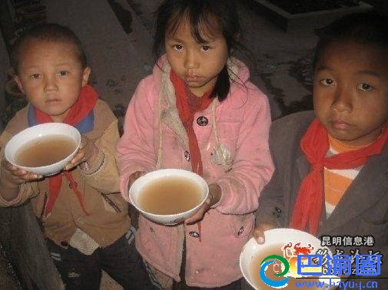
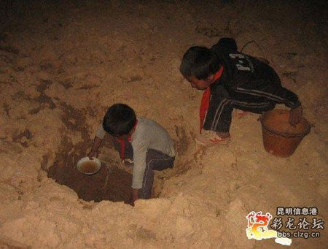
They are looking forward to the rain.

Slide 11
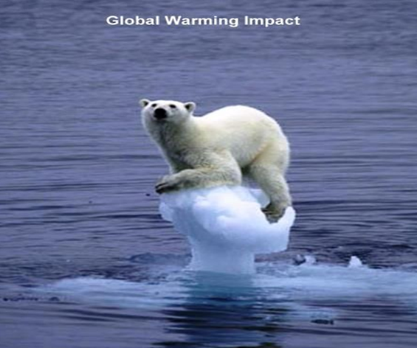
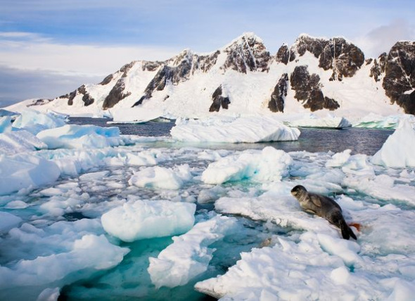
Polar ice melting

Slide 12
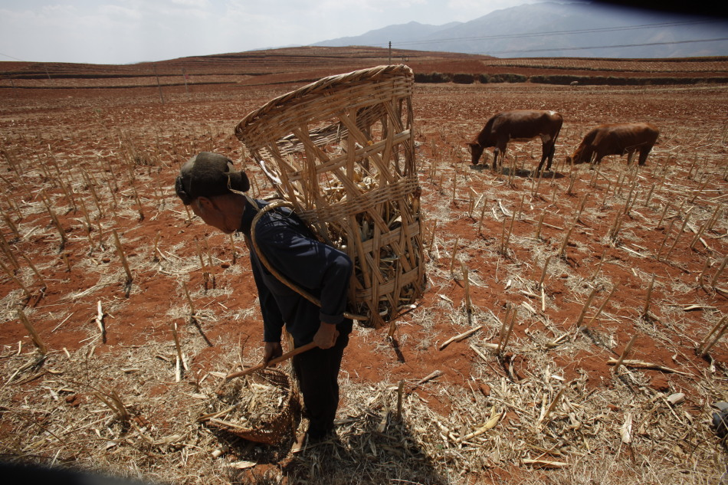
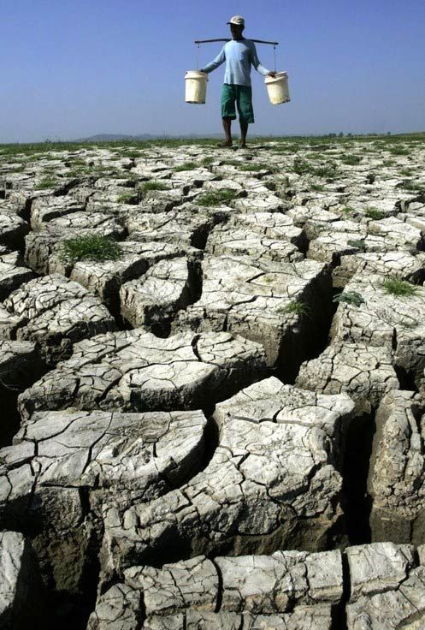
Many parts of the land becomes very dry

Slide 13
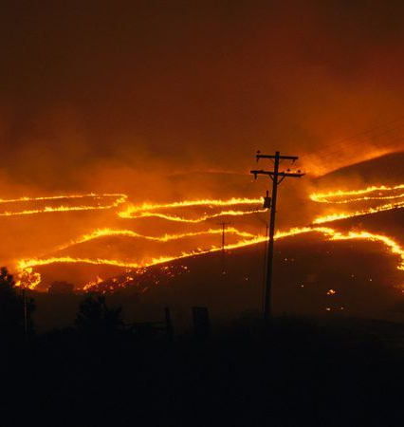
All kinds of extreme weather, droughts, floods, storms, ice storm, fire, use the adjective "rare historical, once in a century" to describe the People lost their homes because of fire.

Slide 14
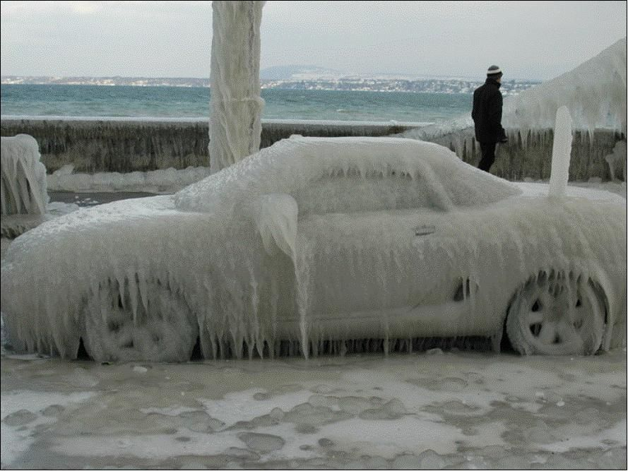
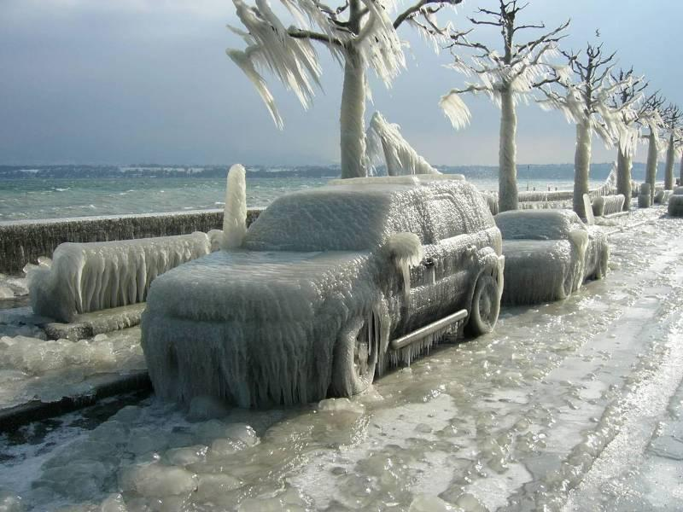
Snow-ice roads and car

Slide 15
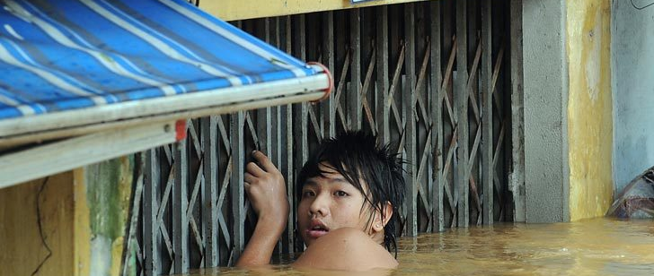
Variety of attacks of extreme weather

Slide 16
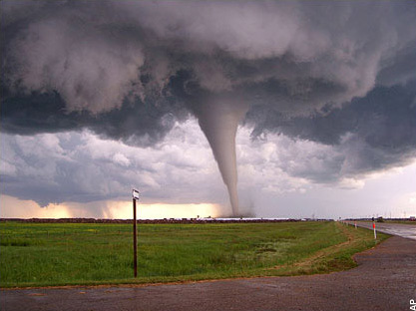
This would cause great harm

Slide 17

We should make every effort to protect the Earth

Slide 18
How can we
live a low-carbon life?

Slide 19
How do we achieve a low-carbon life?
Firstly, we should recognize that low-carbon life is not only a kind of lifestyle but also life attitude.
Secondly, we should develop a good habit of low-carbon life in our daily lives.

Slide 20
What actions we can do?
Let me talk about it from all aspects in our life

Slide 21
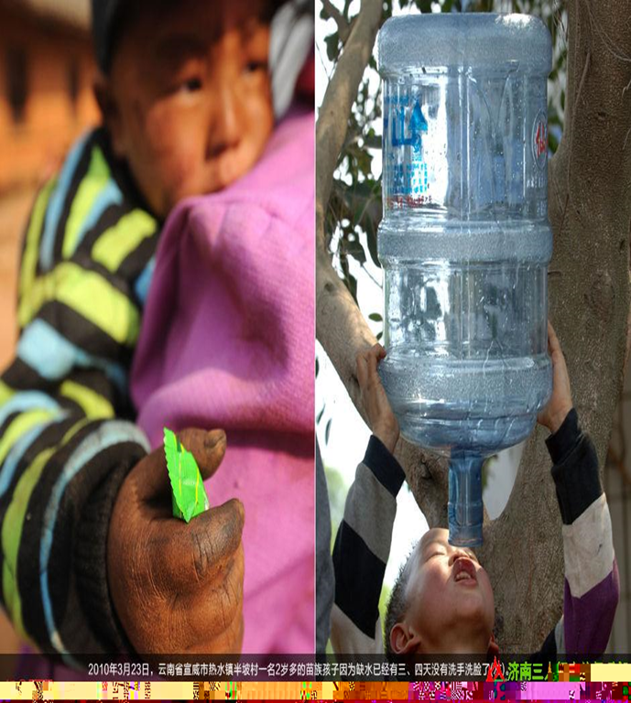

Water is our source of life

Slide 22
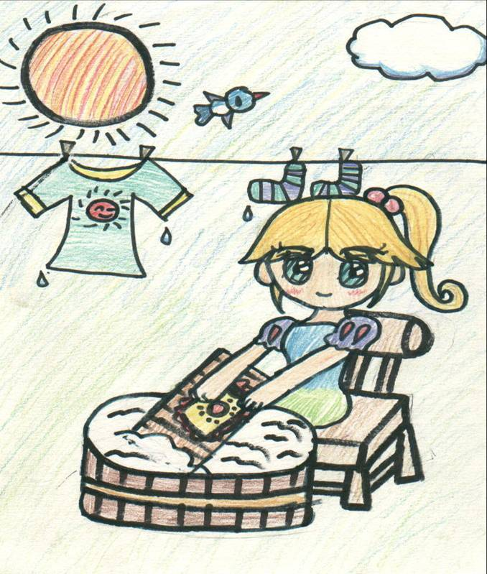
All the family can do monthly by hand to wash clothes, reduce the emissions of carbon dioxide once is 68.4 tons.

Slide 23
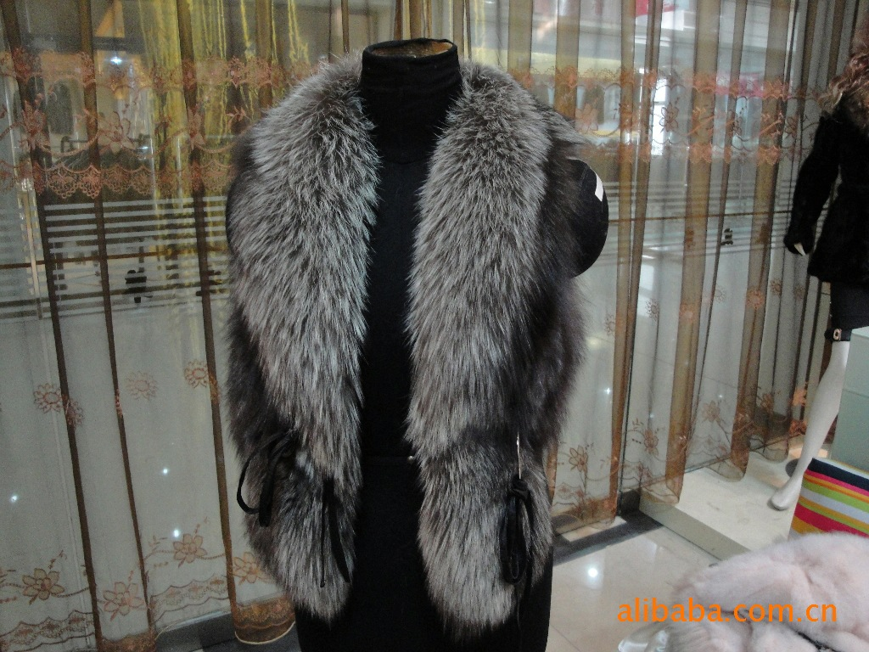
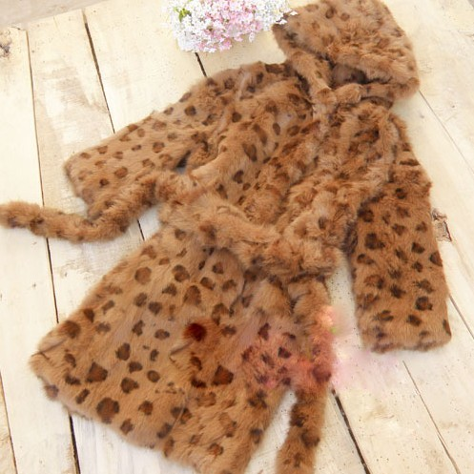
Refuse to buy any fur or fur-trimmed clothing

Slide 24

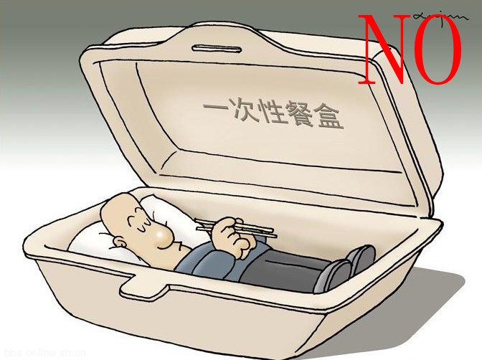
Don’t use disposable chopsticks and disposable lunch box

Slide 25
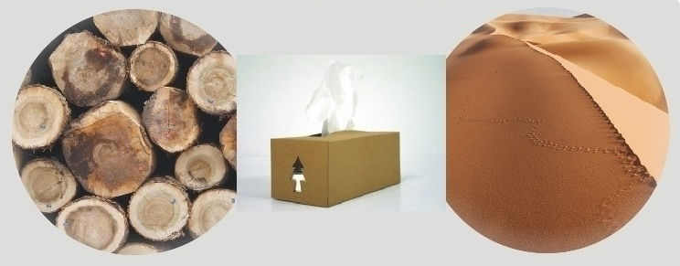
Save paper and save green plants to prevent expanding deserts

Slide 26
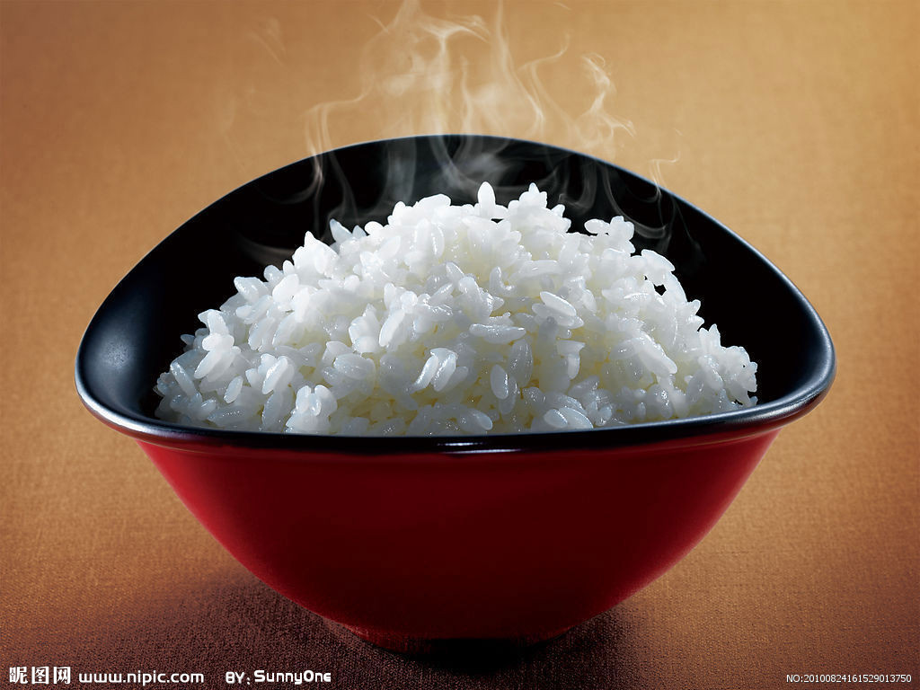
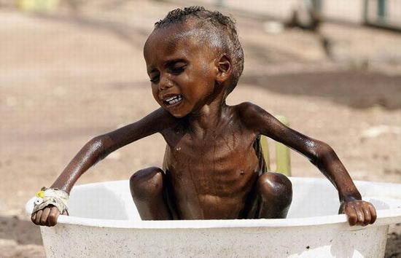
Reduce food waste

Slide 27
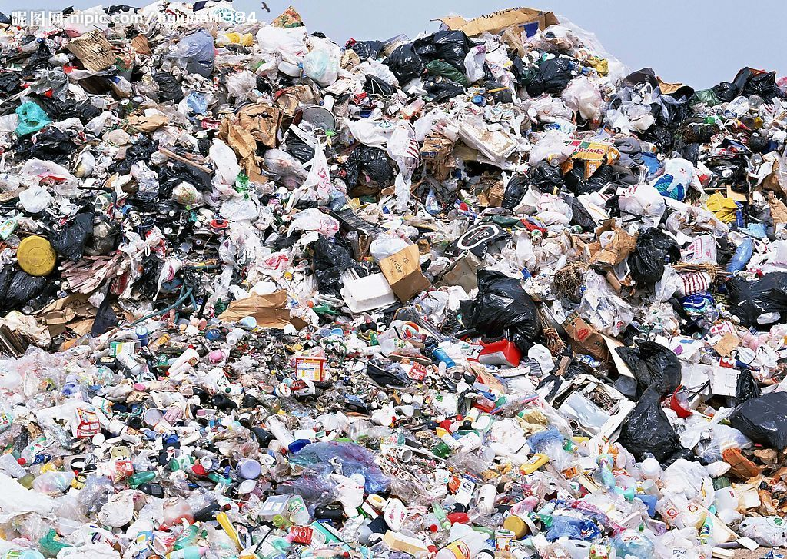

Recycle Bags instead of plastic bags is a wise choice

Slide 28
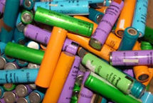
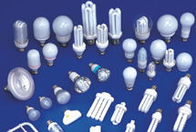
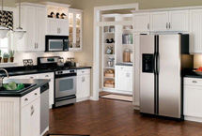
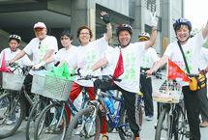
Recycling the old battery
Using energy-saving bulb
Turning off the power socket Timely
Choosing the bicycles ， bus, and subway instead of motorcar

Slide 29
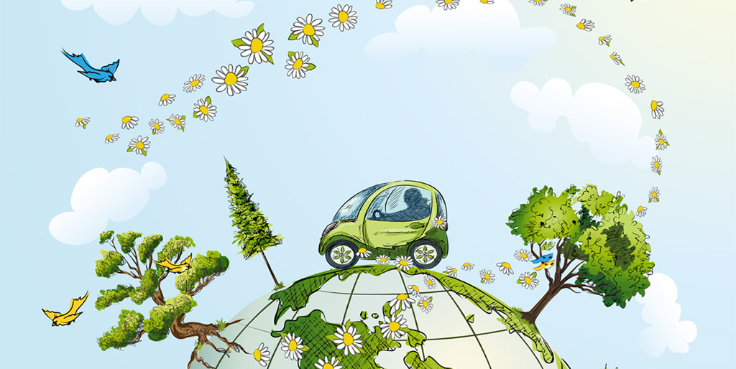

Slide 30
Thank you!

